Slide 1
Capstone Project
Mobile Price Range Prediction Prepared By – Pradeep Gupta

Slide 2
Problem Statement
In the competitive mobile phone market companies want to understand sales data of mobile phones and factors which drive the prices.
The objective is to find out some relation between features of a mobile phone(eg:- RAM, Internal Memory, etc) and its selling price.
In this problem, we do not have to predict the actual price but a price range indicating how high the price is.

Slide 3
Points of discussion
Data summary
Finding null and duplicated values
EDA (Exploratory Data Analysis)
Heatmap to find correlation
Outlier detection
Machine learning algorithms
Logistic Regression
Decision Tree
Random Forest
XG Boost
KNN
SVM
Conclusion

Slide 4
Data Summary
Data set name - Mobile price range prediction
Shape of dataset – 2000 Rows, 21 Columns
Columns –
Battery_power – Total energy a battery can store in one time measured in mah
Blue – Has Bluetooth or not
Clock_speed – Speed at which microprocessor executes instructions
Dual_sim – Has dual sim support or not
Fc – Front camera mega pixels
Int_memory – Internal memory in gigabytes
M-depth – Mobile depth in cm
Mobile_wt – Weight of mobile phone
N_cores – Number of cores of processor

Slide 5
Data Summary (cont.)
Pc – Primary camera in mega pixels
Px_height – Pixel resolution height
Px_width – Pixel resolution width
Ram – Random access memory in mega bytes
Sc_h – Scree height of mobile in cm
Sc_w – Screen width of mobile in cm
Talk_time – Longest time that a single battery charge will last
Three_g – Has three g or not
Touch_screen – Has touch screen or not
Wifi – Has wifi or not
Price_range – This is the target variable with value of 0(low cost), 1(medium cost), 2(high cost) and 3(very high cost)

Slide 6
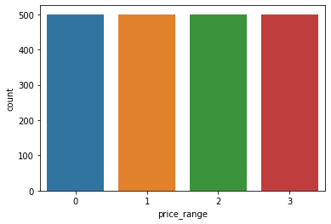
Cleaning the dataset
Pixel resolution height and screen width has some zero values which is not possible in real case so I replaced those zero values with there respective means.
Checked for the null and duplicated values but there was not any null and duplicated values in the dataset.
Price
There are four price ranges for mobile phones, number of phones in each category is almost equal.

Slide 7
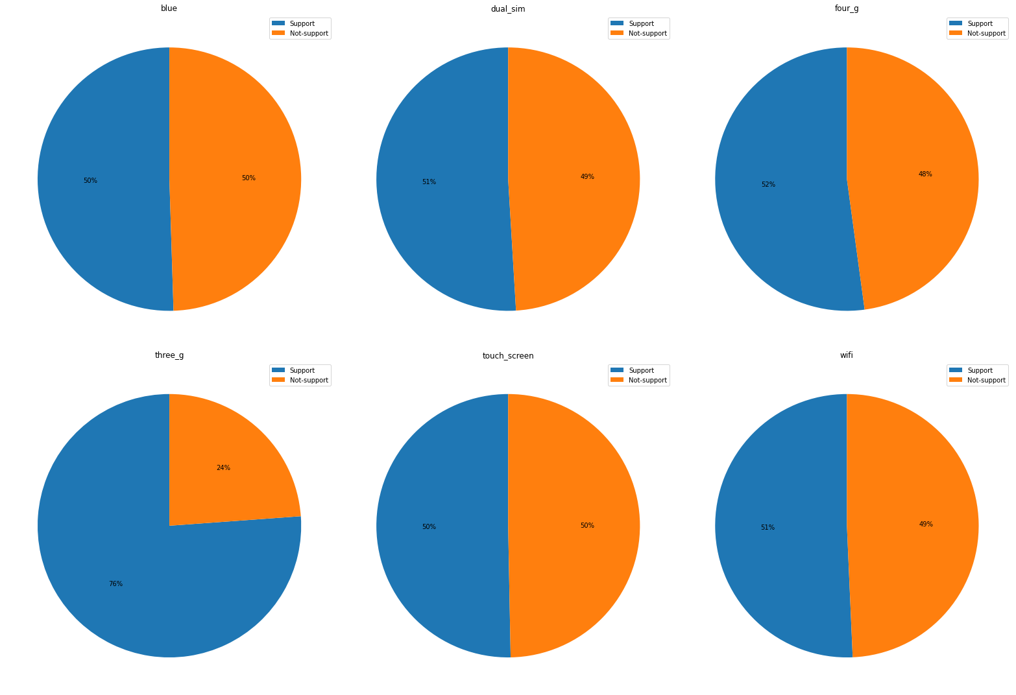
EDA on Discrete Features

Slide 8
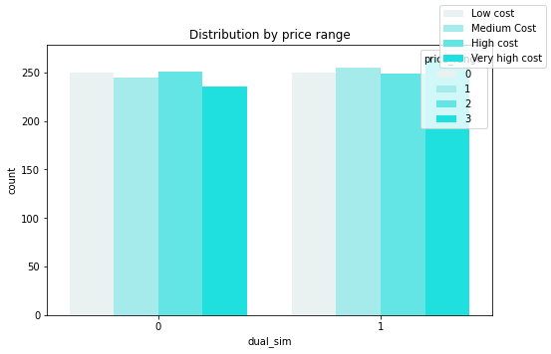
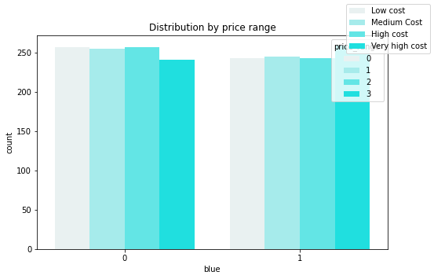
EDA on Discrete Features
50% of mobile phones has Bluetooth. It doesn’t tell much about price category.
51% of mobile phones has dual sim feature but it also doesn’t help much in predicting the price category.

Slide 9
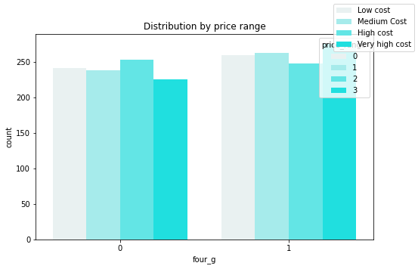
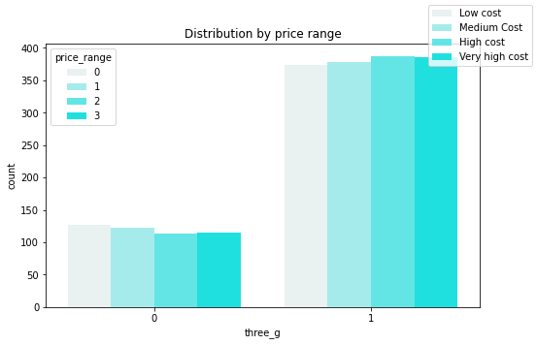
EDA on Discrete Features
76% mobile phones support 3G and cost of phones if it doesn’t have 3G is less as compared to phones which has 3G.
52% of mobile phones support 4G, price of phones if it has 4G is higher.

Slide 10
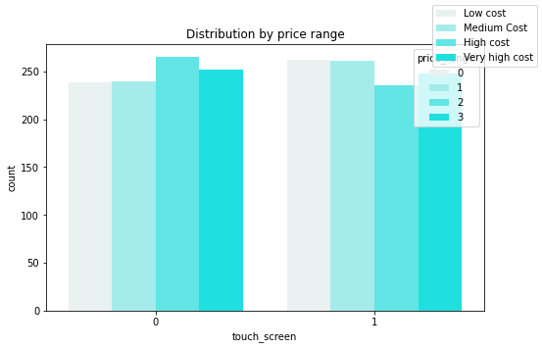
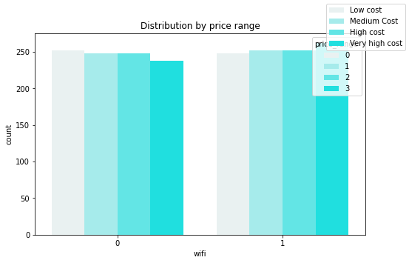
EDA on Discrete Features
50% of mobile phones has touchscreen. It doesn’t tell much about dependent feature.
51% phones has wifi but It also doesn’t tell us much about price category.

Slide 11
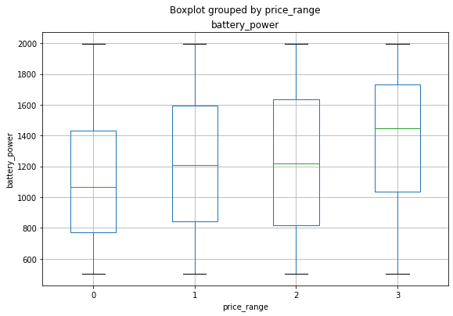
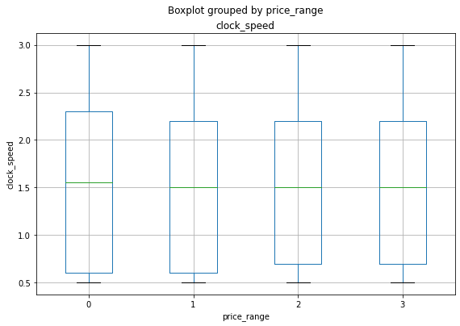
EDA on Continuous Features
We can see as the battery power increases price range is also increasing so it can be our one of the important feature in deciding the price range.
So clock speed of the microprocessor doesn’t help much in predicting the price range.

Slide 12
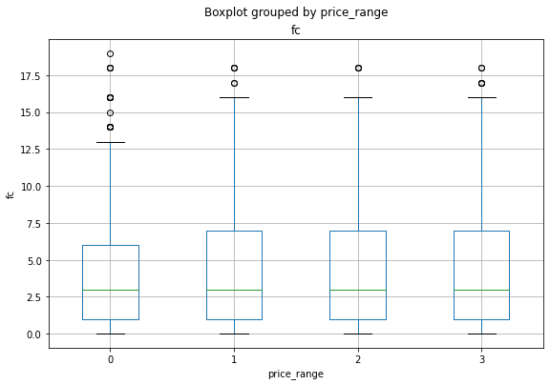
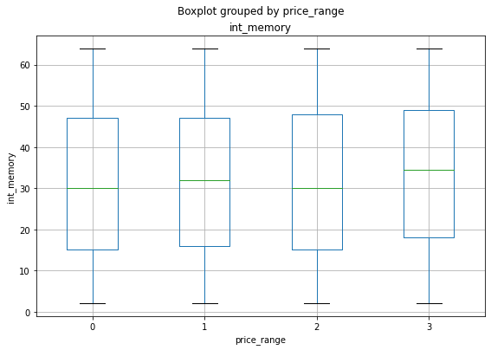
EDA on Continuous Features
Front camera doesn’t help us much in predicting the price range.
Target category is increasing as the internal memory increases.

Slide 13
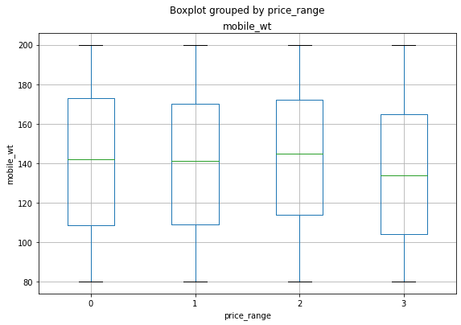
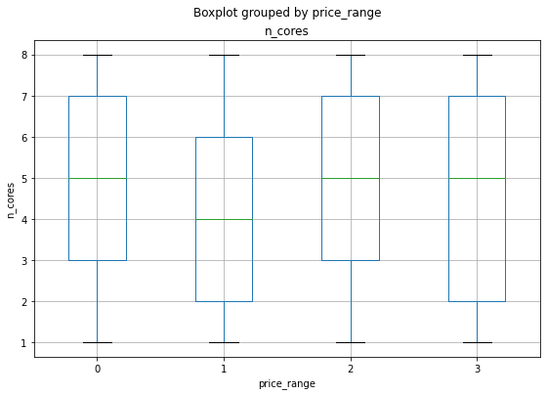
EDA on Continuous Features
We can see if the mobile phone is lighter its price category is higher.
Number of cores doesn’t help much in predicting the price category.

Slide 14
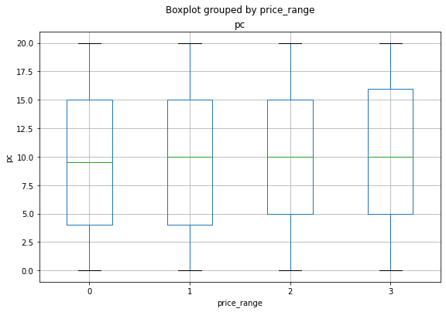
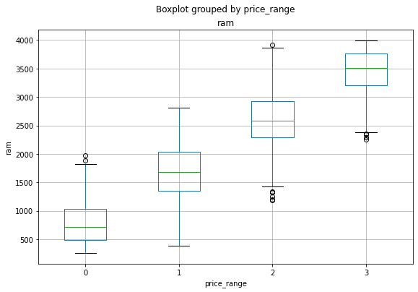
EDA on Continuous Features
Primary camera will help us in predicting the price range because as it creases price category also increases.
RAM can be our most important feature in predicting the price range because costlier mobile phones have high random access memory.

Slide 15
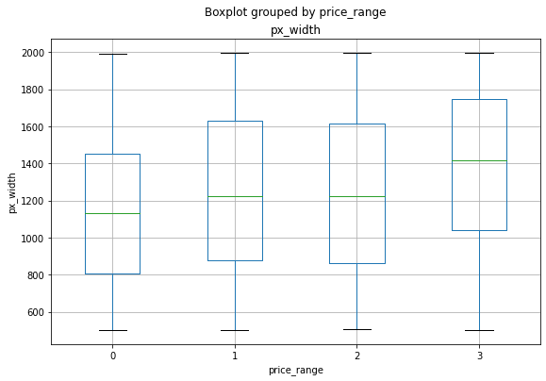
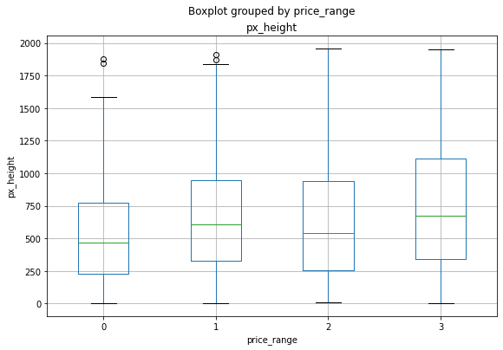
EDA on Continuous Features
Pixel resolution height and width can be our important features in predicting the price. Costlier phones has higher pixel height and width.

Slide 16
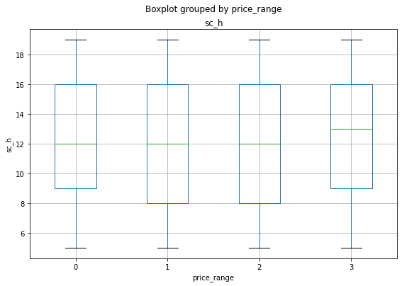
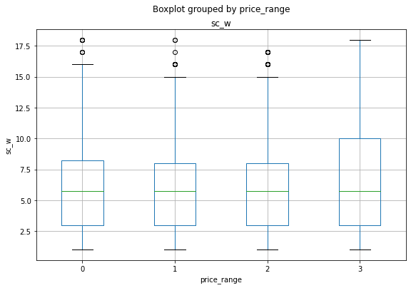
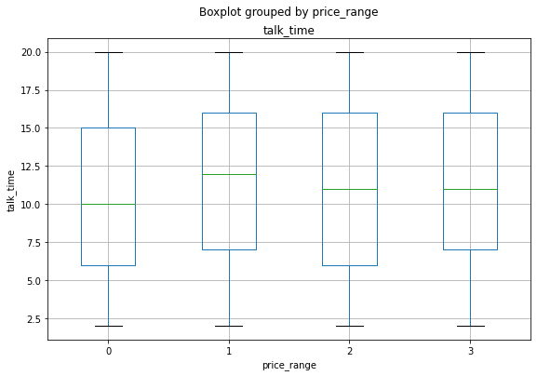
EDA on Continuous Features
Screen height doesn’t tell us much but we can see mobile phones with more screen width has higher price.
As the talk time of mobile phone increases target category also increases.

Slide 17
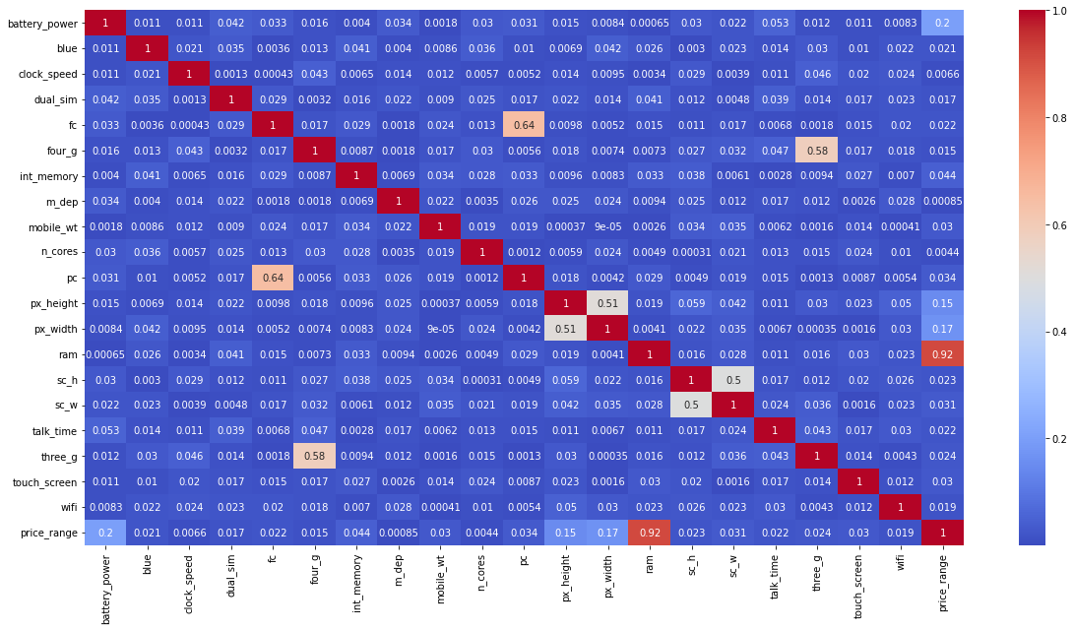
Heatmap to check Correlation
Heatmap showing correlation value of price_range and ram 0.92 means it will be a major factor in deciding the price category.
Four g and three g has some correlation but the target category is depends on these features.
Front camera and back camera also showing collinearity but they are different features and also they can help in predicting the target category.
(px_height, px_width) and (sc_h,sc_w) showing some correlation so I did feature engineering on these and take pixel as px_height*px_width and screen as sc_h*sc_w.

Slide 18
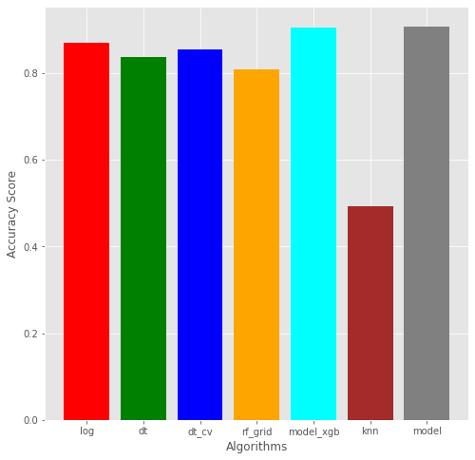
Regression Techniques
Accuracy score with different techniques –
Logistic Regression – 87%
Decision Tree – 84%
Decision Tree with Cross-Validation – 85%
Random Forest – 81%
XG Boost – 91%
KNN – 49%
SVM – 91%

Slide 19
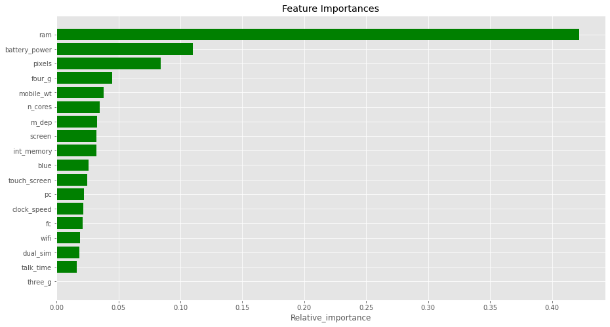
Feature Importance
We can see RAM is our most important feature in predicting the price category for mobile phones followed by Battery power, Pixels(Pixel resolution height and width) and four g.

Slide 20
Conclusion
Price range has four categories 0 mean low cost, 1 mean medium cost, 2 mean high cost and 3 mean very high cost.
76% phones support 3G while 4G is supported by 52% phones.
50% mobile phones has Bluetooth and 51% phones support dual sim feature.
Mobile phones with 4G feature are costlier.
As the battery power of phones increases there price category also increases.
Costlier phones are lighter in weight.
RAM plays a major role in predicting the price category, as the RAM increases price also increases.
Pixel resolution height and width increases price category also increases.
XG boost and Support Vector Machines is best suited for this dataset as they give highest accuracy.

Slide 21
Thank You

